Slide 1
Project: Case Study: FIFA - MoneyBall

Slide 2

IRONHACK BOOTCAMP
OBJECTIVE
Restructuring a Football Club team.
Provide a prediction of player market value.

Slide 3
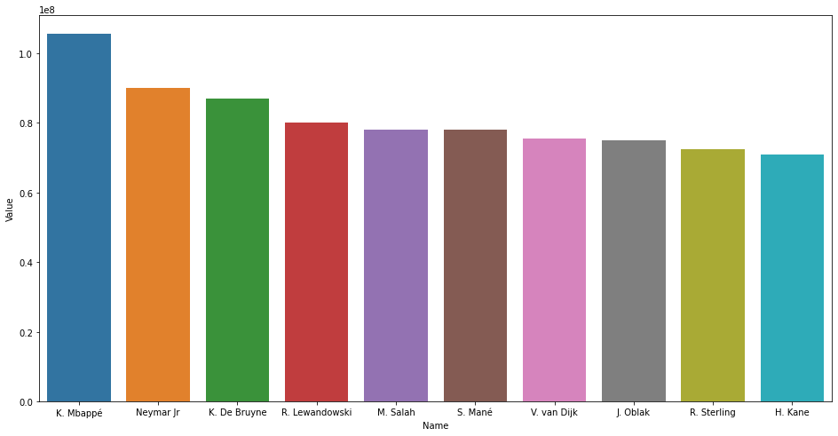
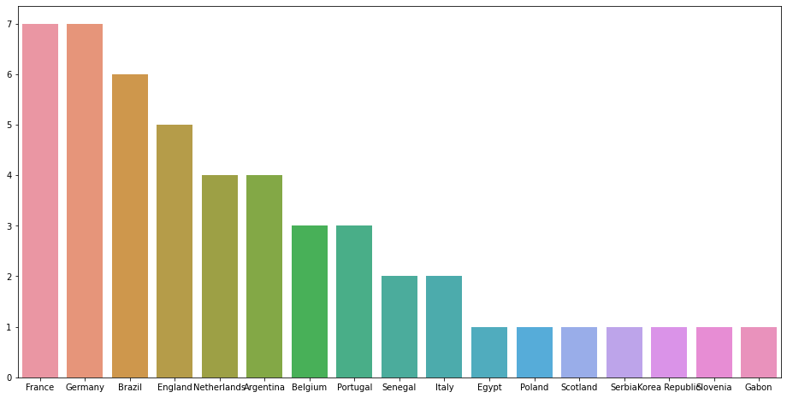
IRONHACK BOOTCAMP
PLAYERS BY VALUE
Top 10 Players Top 50 Players by Nationality

Slide 4
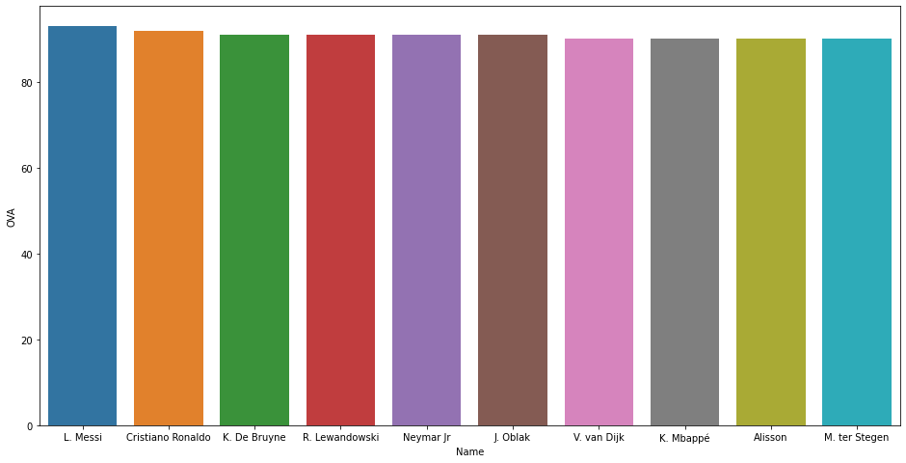
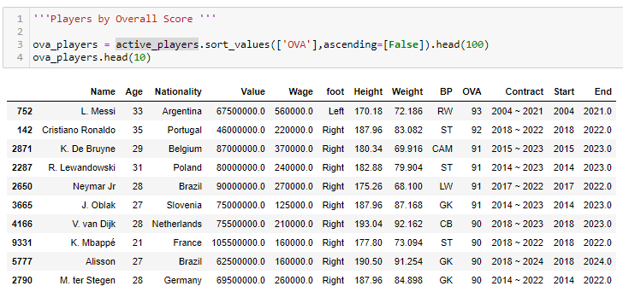
IRONHACK BOOTCAMP
PLAYERS BY OVA

Slide 5
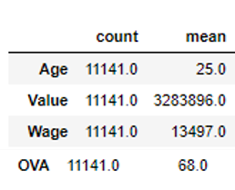
IRONHACK BOOTCAMP
EDA
Notes:
Timeline linear thought from beginning to end, objective

Slide 6
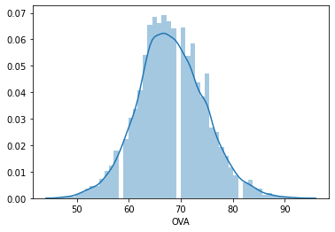
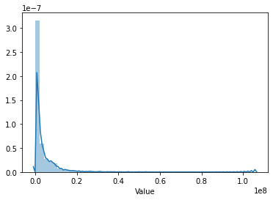
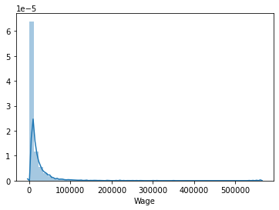
IRONHACK BOOTCAMP
PLOTS

Slide 7
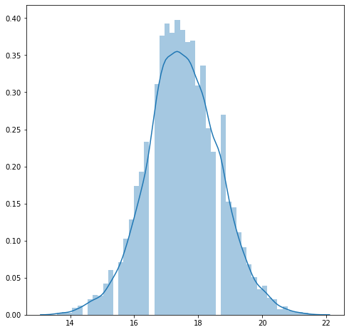
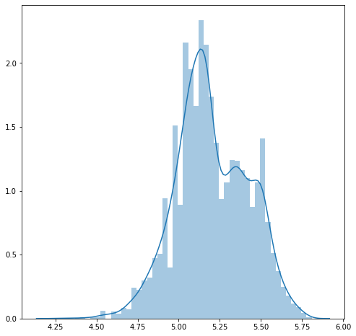
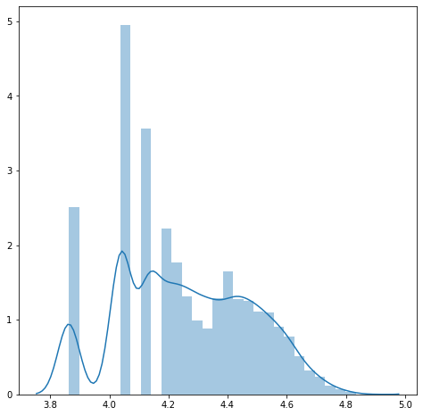
IRONHACK BOOTCAMP
BOX COX PLOTS
OVA Value Wage

Slide 8
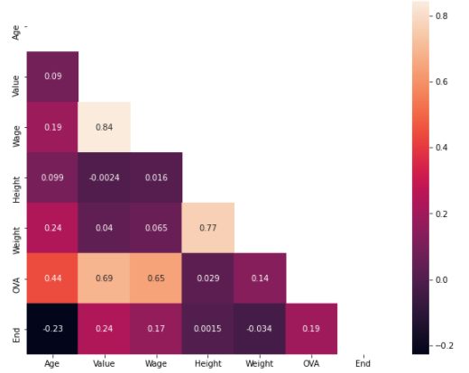
IRONHACK BOOTCAMP
CORRELATION MATRIX

Slide 9
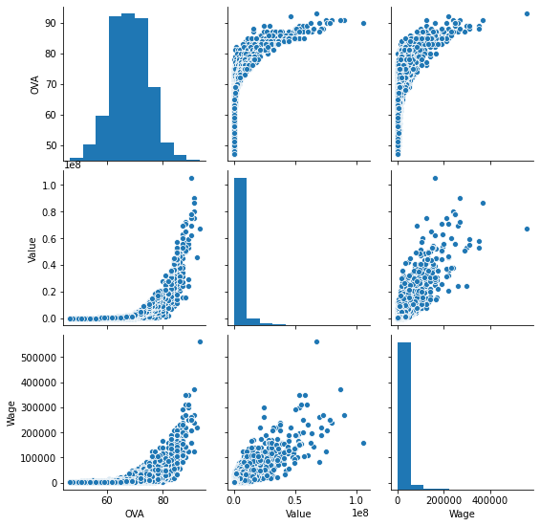
IRONHACK BOOTCAMP
SCATTER PLOTS

Slide 10
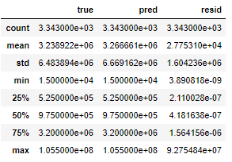
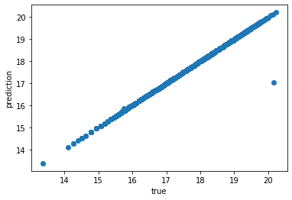
IRONHACK BOOTCAMP
ANALYZYING RESULTS: VALUE
R2 = 0.9971
Mean Absolute error = 10.0107
Mean Squared Error = 10.0342
Notes:
Metrics are very good further investage add graphs here

Slide 11
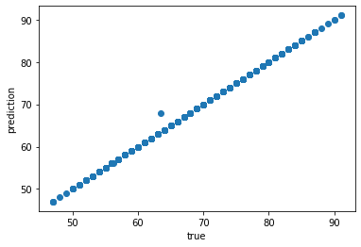
IRONHACK BOOTCAMP
ANALYZYING RESULTS: OVA
R2 = 0.9998
Mean Absolute error = 49.6250
Mean Squared Error = 49.951
Notes:
Metrics are very good further investage add graphs here

Slide 12


